Slide 1

Contract Monthly Claim System
Prog6212 POE Part 3
Mpumelelo Chonco / st10449316
Due Date : 21 November 2025

Slide 2

Overview of System
Purpose: The process simplifies claim submission and approval.
Key Users: Lecturers, Coordinators, Managers, HR
Technology Stack: ASP.NET Core MVC, Entity Framework, Bootstrap

Slide 3

Lecturer Features & Automation
Auto-calculation of totals.
Validation policy in real-time .
File upload with restrictions.
User-friendly design of forms.

Slide 4

Manager /Coordinator Automation
Automated policy compliance checks.
Override Approval Workflow.
Status tracking with visualization of progress.
Bulk approval capabilities.

Slide 5


HR Features
Dashboard with analytics.
Payment processing
Report generation.
Lecturer management.

Slide 6
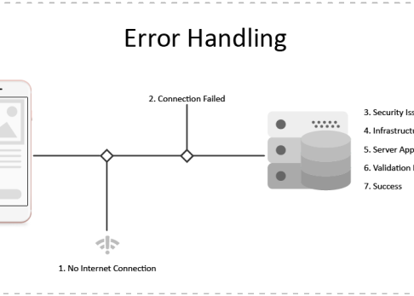
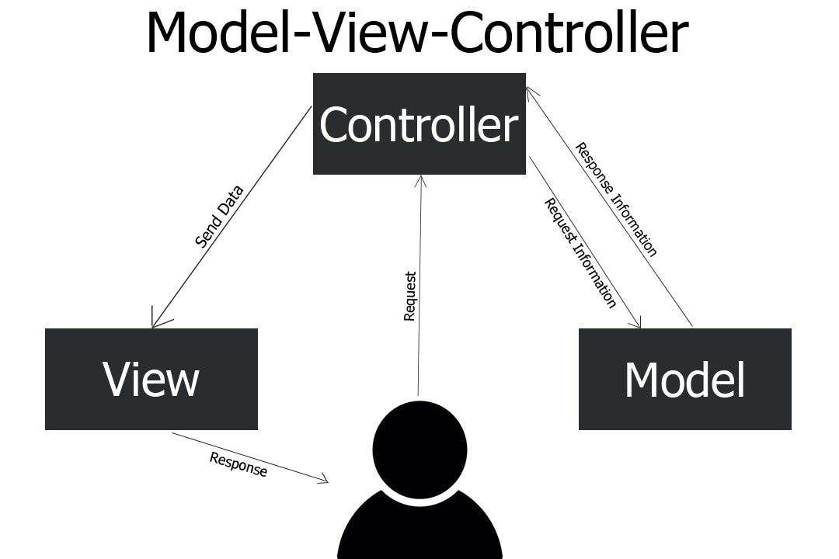
Repository Pattern.
Error Handling & Validation.
Technical Architecture
MVC Pattern.
Entity Framework ORM.

Slide 7




Security & Validation
Policy enforcement.
File type/size limitations.
Input validation.
Error handling.

Slide 8


Status Tracking.
Intuitive navigation.
User Experience
Responsive design.
Real-time feedback.

Slide 9

The Impacts & Benefits
Reduced processing time.
Automated calculations.
Policy compliance.
Transparency of approval process.

Slide 10

Future Enhancement & Conclusion
Payroll systems integration.
Mobile app development.
Advanced analytics.
Successful implementation.

